Slide 1
Microsoft identity platform Overview
We will start at 4 minutes after the hour (or half hour)
1

Slide 2
Before we get started
We are recording the sessions
Please mute your microphone
Please type your questions and comments into the chat
You can also come mute to ask a question or make a comment
Raise your hand in Teams, but this is harder for the presenter to see.

Slide 3
Let’s start with some code
3

Slide 4
What Microsoft identity platform does for developers
Developers delegate Identity and Access Management to Microsoft Identity
Authenticates users
UserID and Password, MFA, Passwordless
Authorizes applications to access resources
Robust directory data with Microsoft Graph
Access to the data that drives productivity across Microsoft 365
For Independent software vendors (ISVs)
Provision users to the app
Verifies app publishers

Slide 5

An increasingly large threat landscape
230
78
5
1/3
%
GB
B
Increased in password spray attacks in 2020¹
of data is uploaded monthly to risky apps by the average enterprise¹
Attacker-driven sign-ins detected in August 2020¹
of all attacks on enterprise accounts involve phishing¹

Slide 6


Old World vs. New World
Users are employees
Employees, partners, customers, bots
Corporate managed devices
Bring your own devices and IoT
On-premises apps
Explosion of cloud apps
Monolithic apps
Composite apps & public restful APIs
Corp network and firewall
Expanding Perimeters
Local packet tracking and logs
Explosion of signal

Slide 7






A new reality needs new principles
Verify explicitly
Use least privileged access
Assume breach

Slide 8
Microsoft Zero Trust
X
A proactive approach to security that uses adaptive controls and continuous verification to prevent and respond to threats more quickly and efficiently
SAAS

Slide 9

Microsoft Zero Trust architecture
Classify, label, encrypt
Data
Identities
Organization policy
Multi-factor authentication
Adaptive access
Apps
User/session risk
Security policy enforcement
Real-time policy evaluation
Device risk state
Access and runtime control
Infrastructure
Device inventory
Devices/ Endpoints
Threat protection
Threat intelligence
Visibility and Analytics
Network
Automation

Slide 10

Microsoft’s Zero Trust enabling technologies
Classify, label, encrypt
Data
Intersectional policy assessment (context, risk)
Identities
User requests access to resource
Microsoft Information Protection
Azure Active Directory
Resource directs to AAD for auth
Route through CASB
Apps
Azure AD Conditional Access
Policy enforcement
Apply controls and assess for anomalies
Microsoft Cloud App Security
Microsoft Defender for Endpoint
Infrastructure
Devices/ Endpoints
App and/or device health and security verified
Network security verified
Intersectional risk assessment (threat intel, familiarity)
Azure Security
Microsoft Endpoint Manager
Intelligent and automation
Network
Azure Sentinel and Microsoft Defender XDR
Azure Networking

Slide 11








Microsoft identity platform for developers
Build applications and integrate identity with one unified toolkit
OIDC Certified Endpoints
Microsoft Authentication Libraries
For clients and services
Endpoints
Libraries
Web API
Including Microsoft Graph, Azure, and your own APIs
Azure portal and Microsoft Graph APIs
Web API
Publisher verification
Work and school accounts
Azure AD
Personal accounts
MSA
Customer and Partner accounts
Supported identities
Azure AD External Identities (includes Azure AD B2C)
Industry standards

Slide 12
Cloud Identity Provider
12

Slide 13
Cloud Identity Provider
Available to any app anywhere
Access to https://login.microsoftonline.com required
13

Slide 14



Cloud Identity Provider
Available to any app anywhere
Access to https://login.microsoftonline.com required
WS-Federation
14

Slide 15
Protocols do not guarantee security, Developers do
Modern protocols have flaws:
Token replay to client (implicit Grant) – Nonce
Token replay to server – Timestamps, session IDs
Token caching
Token lifetimes
Make sure your developers are using a library or are fully invested in implementing the protocol and its recommendations
Microsoft Libraries (MSAL) best choice when using Microsoft identity platform

Slide 16
Microsoft Authentication Libraries (MSAL)
MSAL for Android | Android
MSAL Angular | Single-page apps with Angular and Angular.js frameworks
MSAL for iOS and macOS | iOS and macOS
MSAL Go (Preview) | Windows, macOS, Linux
MSAL Java | Windows, macOS, Linux
MSAL.js | JavaScript/TypeScript frameworks such as Vue.js, Ember.js, or Durandal.js
MSAL.NET | .NET Framework, .NET Core, Xamarin Android, Xamarin iOS, Universal Windows Platform
MSAL Node | Web apps with Express, desktop apps with Electron, Cross-platform console apps
MSAL Python | Windows, macOS, Linux
MSAL React | Single-page apps with React and React-based libraries (Next.js, Gatsby.js)
Learn about MSAL - Microsoft identity platform | Microsoft Docs

Slide 17
Fast and simple integration Authentication libraries
Secure access to users and data made simple
Microsoft’s (Microsoft Graph, other APIs)
Your own APIs
MSAL - best in class auth libs
Reach any audience
Follows Microsoft Security Development Lifecycle
ADAL (and Azure AD Graph) end of support June 30, 2022
https://aka.ms/ADALAADGraph
MOBILE APP
CLIENT SDK

Slide 18
What we hear from customers
Increased visibility and control
More proactive decisions, easier reactive ones
Systems should keep data safe and reduce decision burden
Accelerated app adoption for trustworthy developers

Slide 19
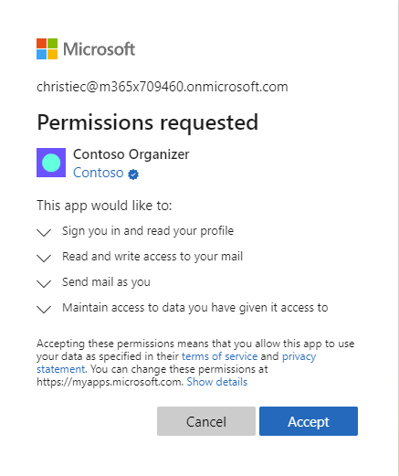

Slide 20
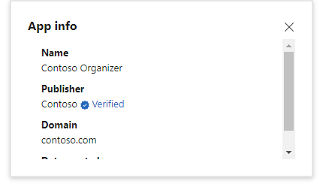

Slide 21
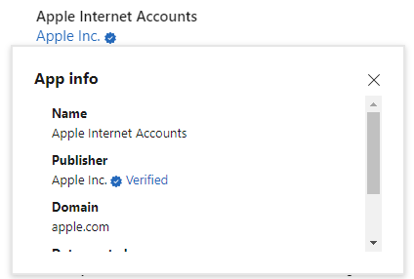

Slide 22
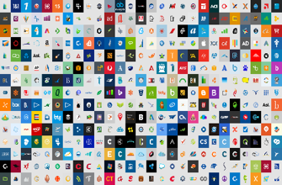












Azure AD for partners and customers
CONNECT WITH CUSTOMERS
COLLABORATE WITH PARTNERS
contoso
Social IDs
Business & Government IDs
22
On-premises & web apps

Slide 23
What is automatic user provisioning?
Allows IT admins to automate the creation, maintenance and removal of user identities in one or more target identity stores.
These actions are based on changes to users/groups in Azure AD or HR profiles.
Also called “Joiner-Mover-Leaver” scenarios
HR Data
User Profile Data
Legal Name
Preferred Name
User ID
Custom Attribute(s)
Job Data
Worker Type
Employee ID
Position Info
Business Title
Work Address
Manager
Company/Division/Department
Dates
Hire Date
First Day of Work
Effective Dates
Last Day of Work
AD, Azure AD and SaaS apps

Slide 24
What is SCIM?
SCIM is an emerging standardized protocol and schema for managing users and groups. More info: http://www.simplecloud.info/
Experienced growth of adoption in 2015-2016 among popular SaaS apps like Workplace by Facebook, Slack, and Github
Many of our pre-integrated connectors in the app gallery happen to use SCIM
We also have a generic connector for non-gallery and custom apps that implement SCIM 2.0. More info: http://aka.ms/SCIM

Slide 25

Let’s start with an app
Decisions:
Trust Microsoft identity platform
How will customers trust your app
Work for the user or as the app itself
What resources are required and when
When to ask for permission to a resource
25

Slide 26
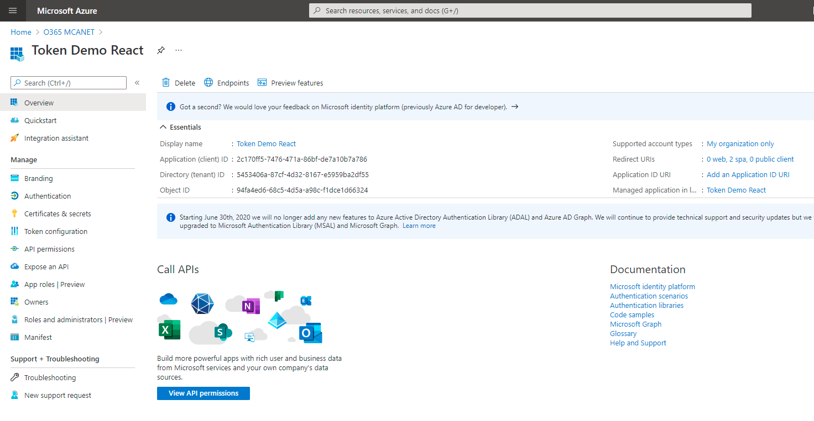
App Registration: App Trusts Microsoft identity platform
What Azure AD considers “the app”
Information about the app:
Name, logo, and publisher
Reply URLs, Secrets, …
One App Registration per App
“Application Object”

Slide 27
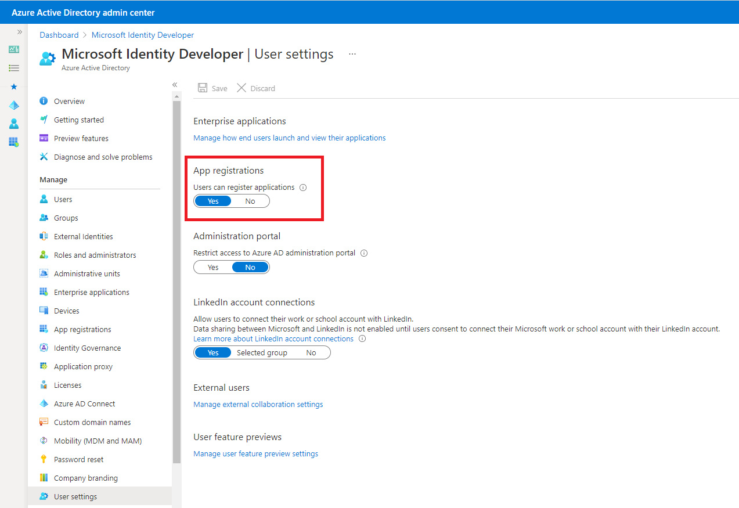
App Registration: Who can register an app
Admins decide who can register apps in their tenant

Slide 28
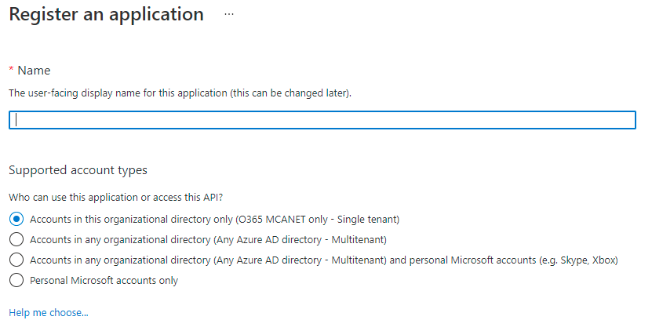
App Registration: Support account types?
Second required question when registering an app.

Slide 29
“Accounts in this organizational directory only”
Only allows users from the tenant where the app is registered
Single-tenant
App
Adatum tenant

Slide 30

Registering the app is not enough
Need:
User and group application and role assignments
Permissions granted to the application
Policies including conditional access policy
Alternate local settings for an application
Visible in Enterprise Applications
Service Principal
SP
App
Adatum tenant

Slide 31
“Accounts in any organizational directory”
Allows users from any tenant
Multitenant
Can optionally include Microsoft personal accounts (Outlook.com, …)
Registered in its “Home” directory (same process as single-tenant)
Admins decide who can consent to apps in their tenant
SP
App
Adatum tenant

Slide 32
“Accounts in any organizational directory”
Allows users from any tenant
Multitenant
Can optionally include Microsoft personal accounts (Outlook.com, …)
Registered in its “Home” directory (same process as single-tenant)
Admins decide who can consent to apps in their tenant
SP
SP
App
Adatum tenant
Contoso tenant

Slide 33
Multitenant App vs External Identities (aka B2B)
Adatum
Contoso
Adatum App Registration
Adatum Data
Contoso Data
User A
User B
User B
Multitenant app
Uses common endpoint to sign in
No invitation/external account needed

Slide 34
Multitenant App vs External Identities (aka B2B)
Adatum
Contoso
App Registration
Adatum Data
User A
User B
User B
External Identities
Use Adatum endpoint to sign in
Can’t use common endpoint
Invitation/external account needed

Slide 35
Demo Application registration
35

Slide 36
Microsoft identity platform
Standards based cloud endpoint
User Authentication
App Authorization
Microsoft Authentication Library family
Microsoft Graph
Provision Users to apps
Verified app publishers
Control Plane for today’s apps

Slide 37
Microsoft identity platform
For Labs and Exercises please refer to the link below -
Getting Started with Microsoft Identity - Learn | Microsoft Docs

Slide 38
38

